Slide 1






A community based platform connecting
global Family Offices (FO) to their ‘multi-generational family’ clients
www.valenprogram.com
Investor Summary
24.10.2022

Slide 2






VALEN’s community platform enables Family Offices to seamlessly deliver a customised service to their multi-generational families
VALEN
Multi-Generational Family
Family Offices

Slide 3





VALEN addresses the complex and evolving needs of multi-generational families
VALEN
Multi-Generational Family
Family Offices
Differing generational objectives
Unmanageable data and control
Instant information access
Families expecting instant ‘gratification’
New wealth seeking first experiences – old wealth seeking better ones
Inflection point – inability to process families’ rich ecosystem data
Increasingly sophisticated families expecting instant access to information
Any where…
Any how……
Any one…….
Any price…….

Slide 4
VALEN addresses the challenges faced by Family Offices in supporting their clients
VALEN
Multi-Generational Family
Family Offices
An antiquated mind set of current generation of FO service providers
The lack of skills & access to resources
The lack of digital operational tools
The increasing cost of supporting FO
Quantum leap required in organisational philosophy
Significant void in availability of `top-end` umbrella solutions to `capture and manage` data flow
FO industry behind the digital curve. Moving from ‘Excel’ to “virtual’
Growing market – struggling suppliers. Restrained by cost

Slide 5
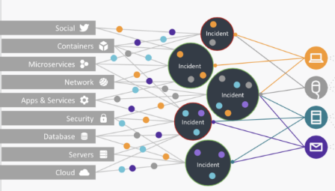
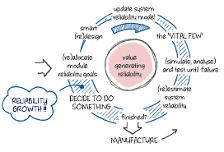
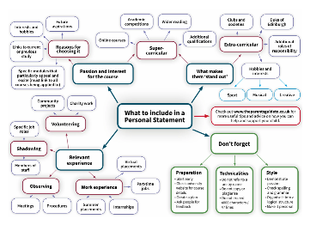
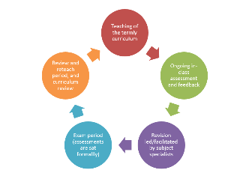
VALEN … is a digital platform that delivers a needs-based organisational and reporting (Lifestyle, Growth, Succession and Protection) service from a wide range of providers (via the Family Office) in an integrated and seamless manner
VALEN
Multi-Generational Family
Family Offices
Assess, Integrate, Aggregate
Analyze, Decide, Allocate – “Needscoping”
Structure, Present, Support
Feedback, Learn, Revise
Valen accesses the wide range of data from all associated stakeholders
Proprietary algorithms based on the “needscoping” philosophy determine the type of service to deliver, when, where, who, how.
Unique ‘operational vocabulary’ places families closer to real-time, richly-informed, decision-making
Feedback loops ensures service is constantly improved over time

Slide 6
A Needs-Based organizational philosophy

Slide 7
VALEN
Multi-Generational Family
Family Offices
Family Needs
Products / Services
Administration facilities for all family governance activities
Health awareness
Maintenance of leisure activities
Family or individual social event planning
Concierge, secretarial and domestic management services
Management of travel and security arrangements
Reporting and administration support arrangements
Daily payment facilities
Concierge, domestic & security services
Personal admin services
Investment adviser (Income)
Banking services
Yacht, plane, transport management
Vacation/Travel management experts
Wellbeing services/Health Screening Experts
Security

Slide 8
VALEN
Multi-Generational Family
Family Offices
Growth perspectives for families
Growth Partners
Strategies, management and growth of family asset base
Planning for growth in physical numbers
Family governance & engagement strategies & customs
Growth of family collective social capital
Growth of the family `story`
Integration & formalisation of family mores, traditions and culture
Personal member growth – social understanding and interaction
Spiritual and emotional growth and wellbeing
Philanthropy service providers and experts
Investment management consulting, execution and custody (capital assets)
Schools, universities, training institutions
Family governance specialists (`Dynastic Strategists`)
Fiscal planning and mitigations experts (lawyers, accountants, tax)
Trustee/mentor involvement with beneficiaries/family members
Counselling and life coaching

Slide 9
VALEN
Multi-Generational Family
Family Offices
Succession perspectives for families
Succession Partners
Strategies to manage succession of family capital including passive assets and businesses
Programs to prepare family members for succession into their chosen official roles within the family ecosystem
Formalisation of arrangements to ensure succession of family tradition and reputation
Trust companies – to establish and manage succession vehicles including trusts and foundations
Estates lawyer - for planning strategies for the succession of estates held around the world and suitable family centric solutions
Family lawyers/governance experts – to undertake family governance and business roles including decision-making training
Trusteeships and family mentor offices – selected experts to undertake these crucial roles for families
Corporate lawyers/accountants – to manage succession of family business assets, across family members and/or into sale phase
Investment adviser – in the capacity of mentors for suitable family members who undertake official roles in this area

Slide 10
VALEN
Multi-Generational Family
Family Offices
Protection perspectives for families
Protection Partners
Insurance and assurance against risk and life-changing events
Ensure family and its assets are protected, both legally and against loss.
Security of family members and their living environment
PR and family governance strategies designed to protect family reputation and image
Protection against cyber-risk
Understanding risk of, and maintaining protection against, impact of poor lifestyle choices
Security services for families and their physical assets
Insurance brokers
Trust, tax, family lawyers
IT security experts
PR firms
Investment advisers` services in the area of loss mitigation

Slide 11
Technology

Slide 12
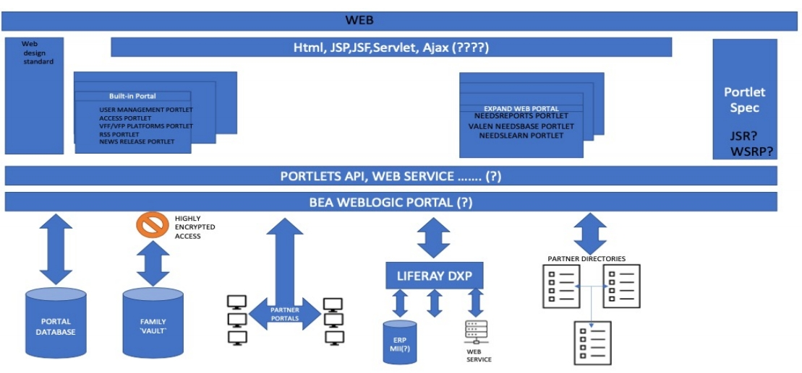
Valen is built on the latest web enabled platform
PLATFORM ARCHITECTURE

Slide 13


VALEN provides a unique user experience, which is individually tailored to the family based on their individual circumstances - known as the “Needsphere’
VALEN’s philosophy is reﬂected within a unique functional, visual and linguistic approach, which
Satisfies the perpetually-changing requirements of each family’s “Needsphere”
“Needscoping” the rich data ﬂowing from families and their service providers into the VALEN Platform to create a common and wide-functioning user interface
Every family lives within its own unique and perpetually-changing “Needsphere” which the VALEN Program has adopted as a primary user interface function
VALEN's organisational tools can also, where appropriate, form the framework within which certain families may wish to deﬁne their entire governance system

Slide 14
Market, Competition, Approach

Slide 15
Deployment into target markets………
Full digital platform Service to UHNW
VALEN ‘mini’ into HNW market
Personal professional networks and targeted marketing stages:
Families with pre-stablished SFOs and MFOs;
Leading Growth, Lifestyle, Succession, Protection service providers AND their family clients,
……..
Mass-affluent market, via:
Wealth management service providers (e.g. banks serving clients USD $4-10m)
Internet marketing campaign
Phase 1 (2 years)
Phase 2 (3-5 years)
*UHNW: Ultra High Net Worth

Slide 16
MARKET SIZE - GLOBAL
Single
…CAGR 2020 to 2028 4.62%... (source: Researchnester.Com)
FOs
2019
USD 17B
2028
USD 27B
All FOs
2020
USD 79B
2026
…CAGR 2021 to 2026 9.8%... (Source: ExpertMarketResearch.Com)
$$$$$$$$$$$$$$$
GROWTH INDICATORS:
- Increasing family wealth, and the changes this brings to families ……need to manage
- Increasing benefits for a wider family market in adopting FOtech/establishing a FO… - Need to manage complexity of geographically spread family presence
- Increasing need for families to outsource solutions
- India….

Slide 17
Valen is approaching a relatively unsophisticated environment, where previous attempts to provide a unifying platform has not succeeded
Large banks
Specialist Software Orgs
Multi Family Offices
MASTTRO
Altoo
Stonehage Fleming
Canopy
JTC
iPaladin
These companies are conflicted in the type and nature of the services they could offer with current `partial` digital solutions
NO current umbrella platforms – mostly investment solutions:
Adapting current `partial` platforms
Th reason Valen will succeed is…………..

Slide 18
Sales lead generation
VALEN
Multi-Generational Family
Family Offices
Direct marketing approach
Existing contacts, tailored pitches
Win pilot project & deliver value proposition validation metrics
Drive SEO through targeted, keyword rich content, awareness
Thought Leadership: Associate key terms (FO Tech) with Valen brand
Market Awareness & Interest via
Outreach campaign to professional networks
Mix of Digital (Social Media) & Traditional (Tradeshow/Conference/Event)

Slide 19

Valen – our approach once engaged with the Family
Define & Scope
Analyze & Decide
Engage & Present
VALEN begins with apply a unique process* to scope in detail the needs of each family member
Complex data flows between all stakeholders (family and suppliers) are mapped
Communication ‘fault lines’ are identified
Control systems and interventions are modelled and implemented
All about how Valen integrates the data
analysis the data against set criteria, etc
How Valen presents decisions to be made and options, etc…
All about how Valen presents the data, improving decision making, etc
* Valen has developed a linguistically advanced needs-based communication & control vocabulary to create a family “Needsphere”

Slide 20
Finance

Slide 21


The Valen Business model is based on franchising the platform to FO for deployment into their Family clients
VALEN
Multi-Generational Family
Family Offices
The virtual FO organisational platform
- for families, their members, and their FOs
Franchising – of entire PROGRAM `package` to Partners seeking to add a virtual FO service to their current offering.
Subscriptions – by FOs; MFOs and VFP Association members:
Platform licenses
Annual support services
Membership subscription
An exclusive Swiss professional members association for Needscoped Growth, Succession, Protection, Lifestyle Partners
owned by “Partners” …powered by VALEN
….

Slide 22
Revenue Forecasts
VALEN PROGRAM - FORECAST BUSINESS NET PROFIT FOR THE PERIOD:
1 JANUARY 2022 TO 31 DECEMBER 2026
 | 2022 | 2023 | 2024 | 2025 | 2026
Income b/f | 310,500 | 1,096,200 | 3,286,400 | 4,861,600 | 8,456,986
Expenditure | (197,200) | (479,450) | (1,287,900) | (1,735,300) | (2,854,500)
Profit | 113,300 | 616,750 | 1,998,500 | 3,126,300 | 5,602,486
Margin | 36% | 56% | 61% | 64% | 66%

Slide 23
Funding Requirements
Financing - sources/offering & valuation
1st Round
6 mths development and launch
CHF 500K
angel investors and/or VCs
2nd Round
at year 2
CHF 500K from
same investors or VCs
3rd round
at year 4
Offering – CLN or equity up front (prefs) of up to 17%
Valuation based on 3rd yr projected net earnings
Start-Up Costs (Full Budgeting forecasts for 5 yrs on request)
CHF 250 - 500K

Slide 24
Team, Partners

Slide 25

TEAM
John Sinclair, LLB, FCILeX TEP
CEO and Legal Counsel Switzerland
Andrew Osborne, MSc
Sales & Marketing, France
Ang Chen, PhD
Systems developer, Switzerland
Duy Nam Vu
Graphic designer
Vietnam
Carlos de Pommes, MSC MBA
Non-exec business, United Kingdom
30 years experience as a legal practitioner in the management, structuring, advising of H/UHNW global families, shareholder, creator of the VALEN concept
XX years experience in business development, sales and marketing, a seasoned professional in the technology and digital solutions field, adept at building value propositions and opportunity pipelines
Computer scientist and software developer engaged to head up the development of the digital platform. Responsible on an ongoing managerial basis as technical director and head of digital services
Graphic designer since 2011, graduate of Vietnam University of Industrial Fine Art. Working in both agency and client’s side, “Visual branding at it finest is always my motivation”.
35 + years experience - serial entrepreneur and management consultant with McKinsey & Co. Founded numerous companies including Remediiate, an industrial carbon reduction enterprise involving algae

Slide 26

Partners
For VALEN business: The strategic business need for “Valen For Partners” creates a unique opportunity for an array of partnering options for the exploitation of the VALEN
Program:
Support services:
Acting as licensing agent for VALEN
as an exclusive VALEN Program “Needscoped” service provider
For Partners, providing a value-added enhancement of their current offering
Business operational support – AccTrust and Dryden CH
Marketing – Make Fresh Tracks (France)
Server hosting and security - SafeHost CH
Software development and Creative – Innodiff CH & Behance (Vietnam)

Slide 27
Benefits Summary

Slide 28




SOLUTION - an industry-disrupting `FO-tech` platform for managing the entire spectrum of family need (4 Core Needs Methodology .. Growth – Lifestyle – Succession – Protection)
CHANGING THE VISION
EXPLOITING THE OPPORTUNITIES
EMPOWERING FAMILIES
OFFERING BENEFITS – TO ALL
VALEN applies a unique
Embracing a paradigm shift from
The first truly virtual FO
Reduces overhead by multiples
“Needscoping” process to the increasingly complex and
traditional FO organizational
platform cutting across the entire spectrum of family life,
through the digitalization of many traditional FO process.
disparate user (Family) and supplier (Services) data flow to
methodology VALEN completes the
digital circle for families and their ecosystems in the supply of a bespoke
VALEN encourages and
Represents a new and appropriate quantum leap in organizational methodology using a bold and
empowers family participation
overcome control and
AI user experience drawing on rich
and nurturing.
communication fault lines extant in current FO modelling.
profile data within analytically-
embedded IT infrastructure.
Through being closer to the
innovative management
Applying linguistically-
decision making process and
philosophy.
using common and human language to understand data in real time enables informed and knowledgeable decisions to be
For suppliers – opens up an
advanced needs-based
entirely new business opportunity to offer, and act as principal in managing the digital VALEN
communication & control vocabulary to create a family
“Needsphere” elevating
made.
alternative as an exclusive service to their most valued client families.
families above white noise,
“prof-speak”.

Slide 29

A new organisational philosophy to serve the entire spectrum of family need
Developed from deep and critical analysis of the current Family Ofﬁce (“FO”) environment and reﬂection on 30 plus years
experience in managing family affairs
A paradigm-shift in multi-service organisation, delivering effective communication and control systems for modern FO arrangements
Using cutting-edge digital tools in the delivery of innovative solutions to the increasingly complex and sophisticated demands of the 21st century global family
Represented in the establishment of the VALEN FOR FAMILIES digital platform and VALEN FOR PARTNERS service providers` association
Placing families closer to real-time, richly-informed, decision-making through the use of a unique operational vocabulary amongst themselves and their professional partners
A new needs-based philosophy: lifestyle, growth, succession and protection
For families seeking a new experience and lifestyle choice in the management of their affairs, which is entirely adaptable and scalable to accommodate:
Cutural or religious backgrounds
Business families or post-sale scenarios
Physical locations of all family members
Any type of family governance framework

Slide 30
Contact:
+41 79 267 54 95
john@valenforfamilies.com

Slide 31
BackUP

Slide 32
Word Salad!!
Valen represents a paradigm-shift in how FOs are supported by their service providers
Valen delivers effective communication and control systems for increasingly demanding families
“A new organisational philosophy serving the entire spectrum of family need”
an industry-disrupting ‘FO-tech’ platform for managing the entire spectrum of family need
A digital platform implementing a radical FO management approach

Slide 33





Slide 34
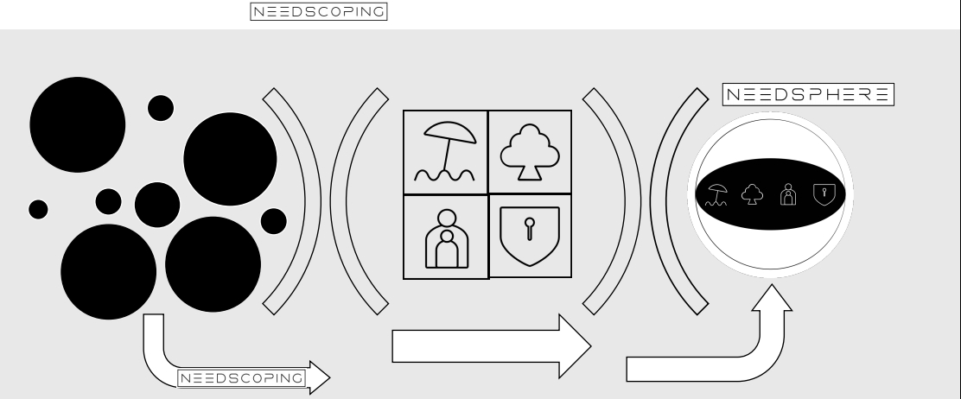
PRODUCT OVERVIEW –
Rich Dispersed Data
Services
Data
d
Family
Data
d
Family
Experts
Data
Data
Assessment-Allocation- Aggregation
Interface-ready/family-
specific Data

